Slide 1

RESTful Web Service using Docker & Spring Boot
-Neerav Poriya

Slide 2
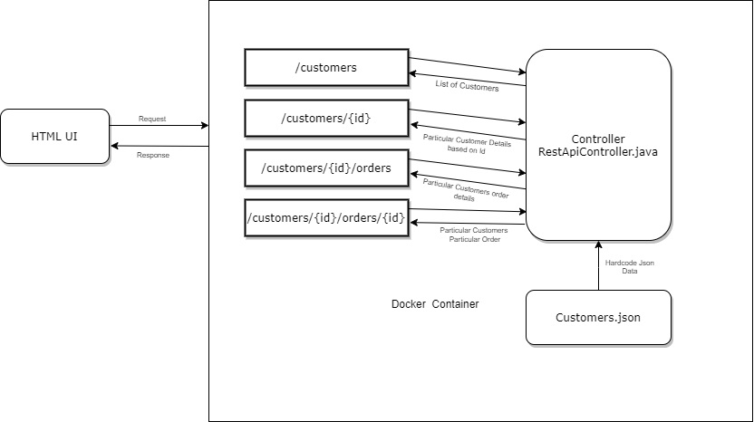
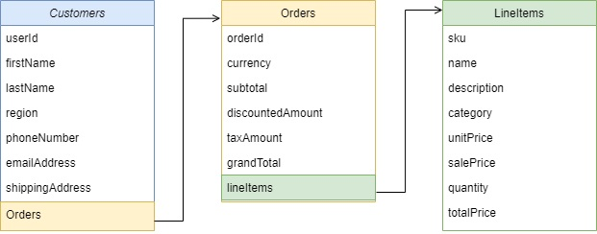
Json File Structure

